Slide 1
UML

Slide 2
What is UML
Unified Modeling Language
OMG Standard, Object Management Group
Based on work from Booch, Rumbaugh, Jacobson
UML is a modeling language to express and design documents, software
Useful for OO design
Not a process, but some been proposed using UML
Independent of implementation language

Slide 3
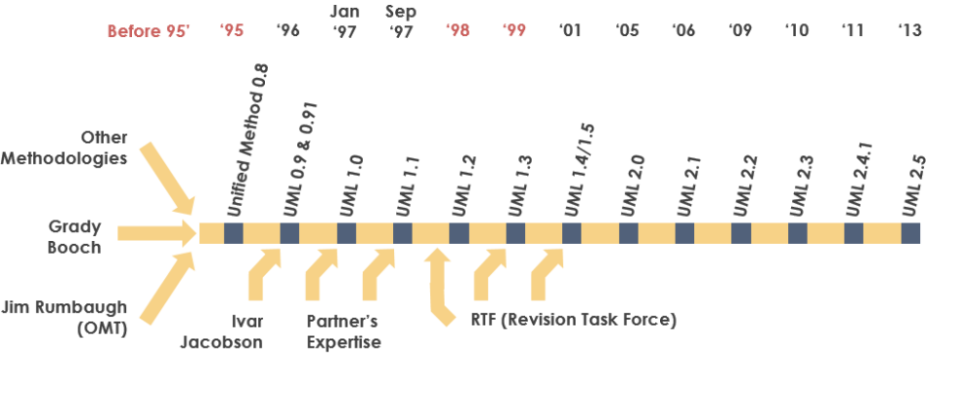
Why use UML
Open Standard, Graphical notation for
Specifying, visualizing, constucting, and documenting software system
Increase undrestanding/communication of product to customers and developers
History of the UML
https://www.uml-diagrams.org/
https://www.visual-paradigm.com/guide/uml-unified-modeling-language/what-is-uml/

Slide 4
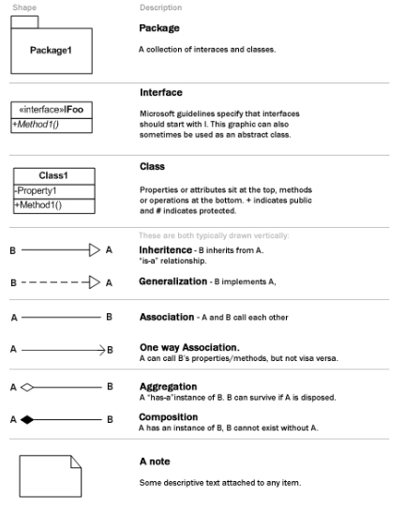
UML Cheat Sheet

Slide 5
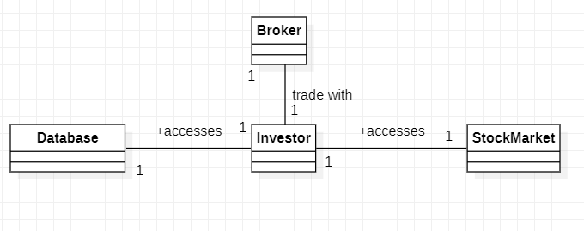
Object class

Slide 6
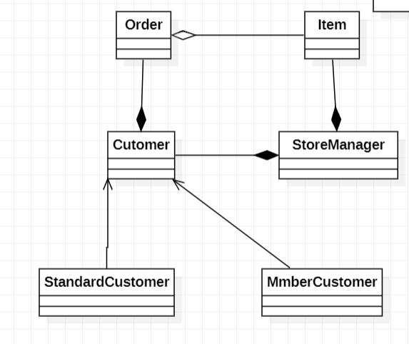

Slide 7
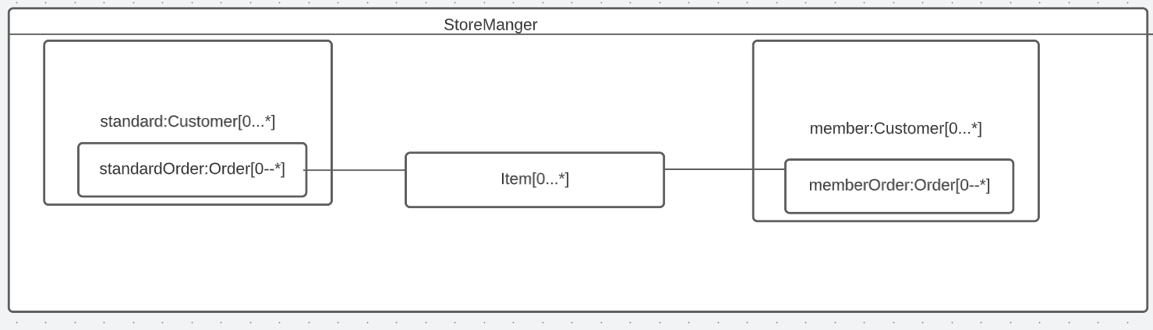
Composit Diagram
A good approach to describe the aggregations

Slide 8
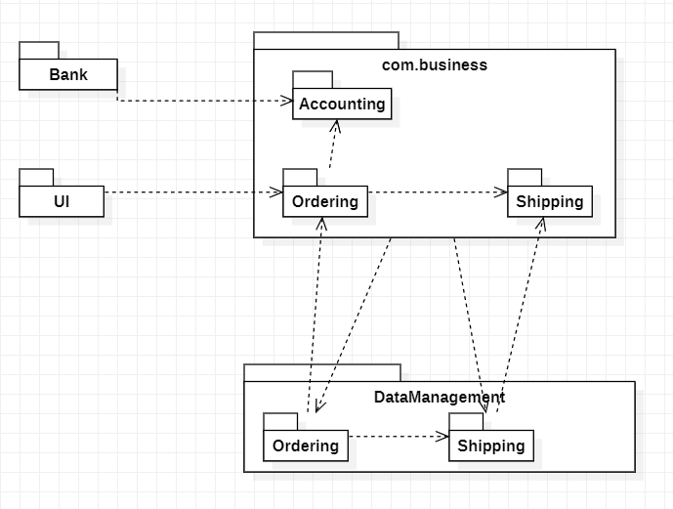
Package Diagram
Dependency

Slide 9
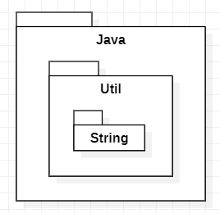
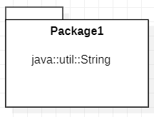
Package
OR

Slide 10
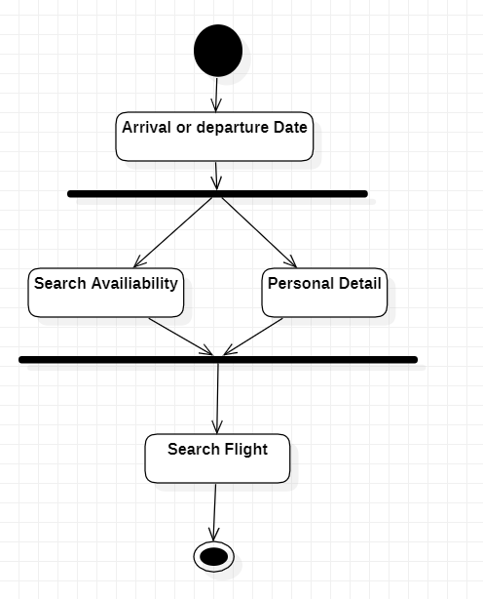
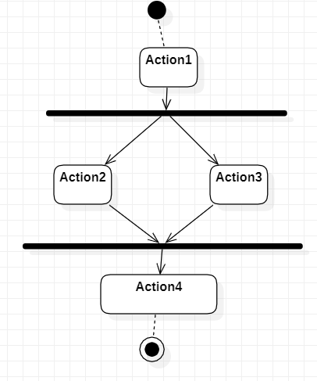
Activity Diagram

Slide 11
Use Case Diagram
Type of use case description
High level- A general description:
Expanded (detailed)-step by step
Essential-free of technological detail
Real-adds technological detail

Slide 12
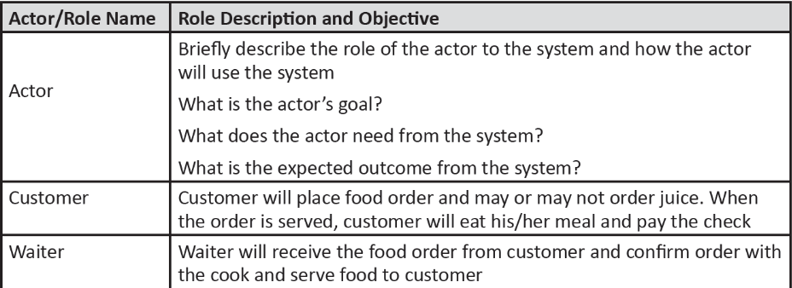
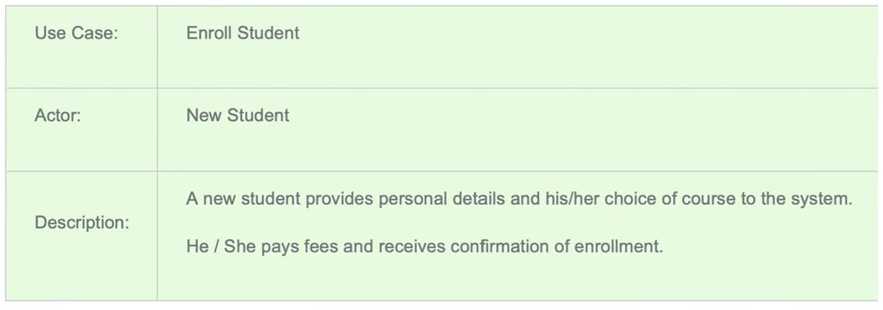
High-level of use case description
http://mohamedelgendy.com/blog/how-to-write-a-use-case-document.html

Slide 13
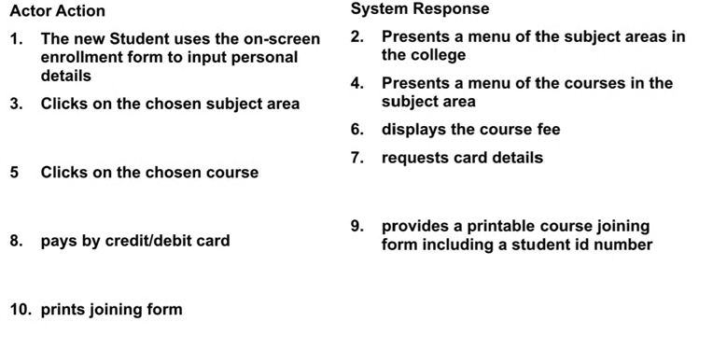
Expanded (detailed)-step by step
Enroll to a course

Slide 14
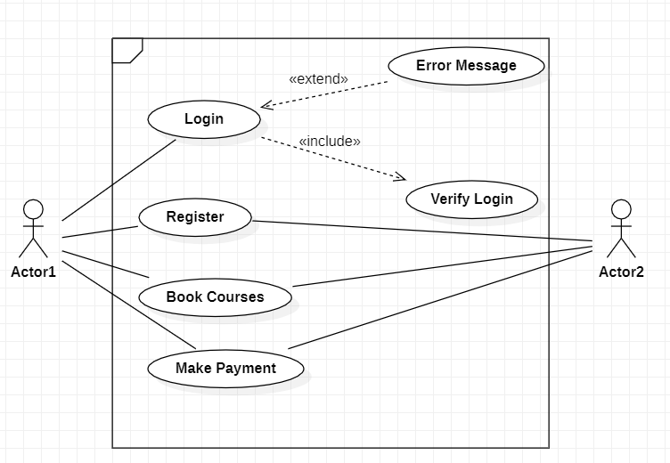
Use Case diagram

Slide 15

State Machine

Slide 16
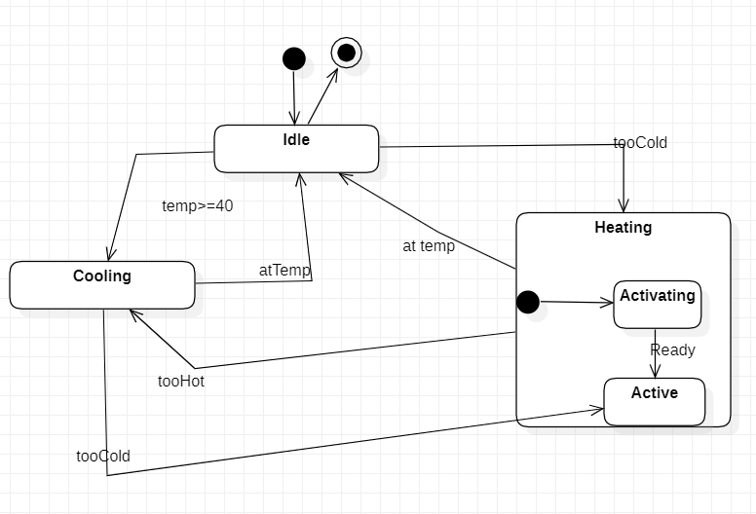
State Machine Diagram

Slide 17
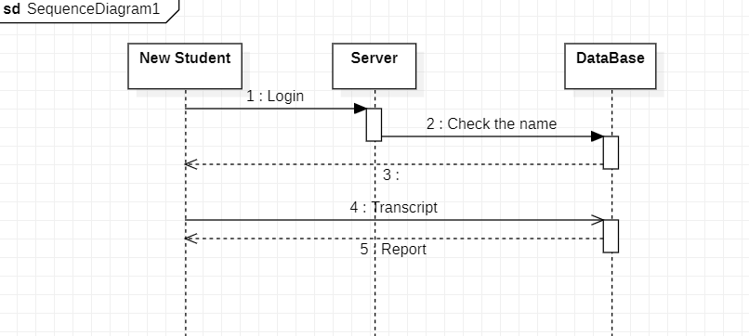
Sequence Diagram

Slide 18
Sequence Diagram 2

Slide 19
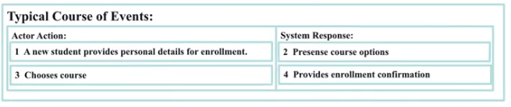
Sequence Diagram
Identified none for classes
Student
Course
Enrollment
We have to define the screen interaction between the use cases

Slide 20
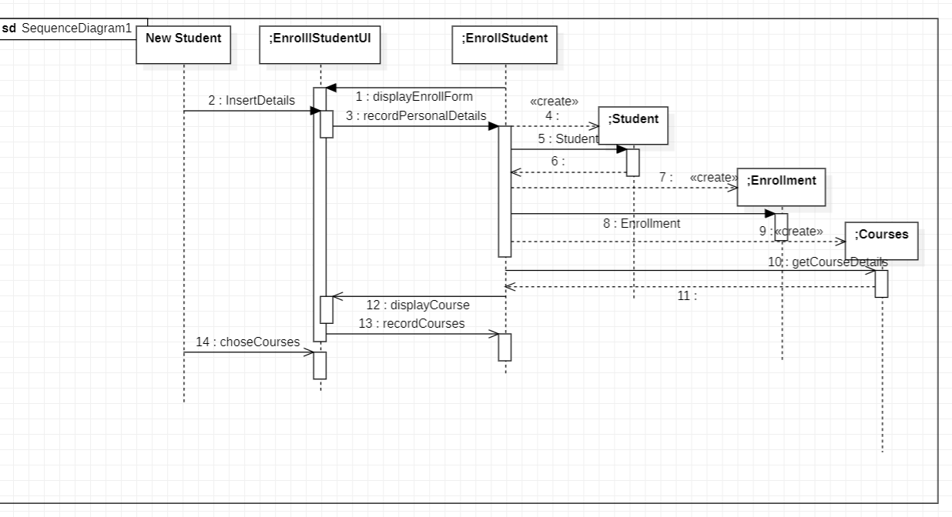
Identify the domain classes
Control Object life

Slide 21
EXAMPLE UML
https://www.uml-diagrams.org/examples/online-shopping-example.html

Slide 22
EXERCISE 1
Propose a use case diagram for an ATM machine for withdrawing cash. Make the use case simple yet informative; only include the major features.

Slide 23
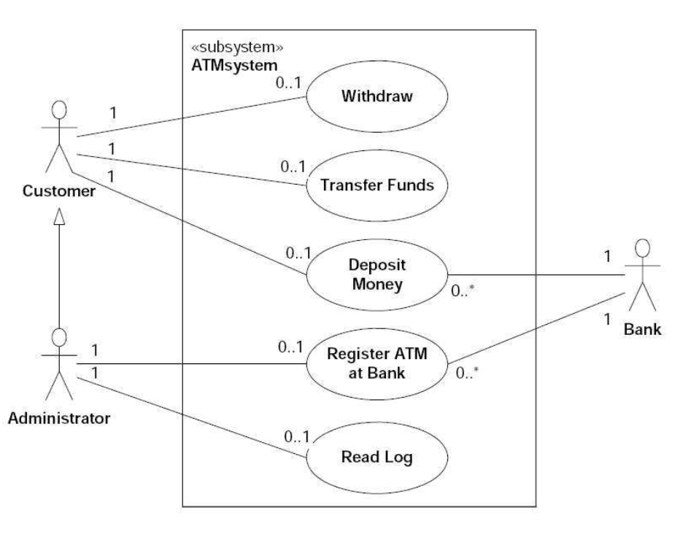
Solution

Slide 24
Exercise II
Propose a use case diagram for a vending machine that sells beverages and snacks. Make use of inclusion and extension associations, mark multiplicities, and remember that a vending machine may need technical assistance from time to time

Slide 25
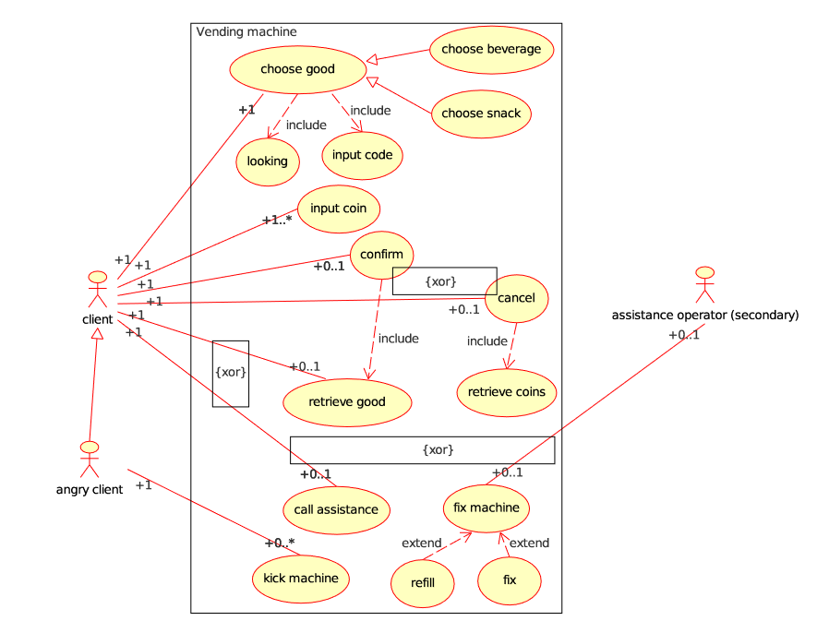
Solution

